Slide 1
Linear Algebra 2
Python Life

Slide 2

Distributive, associative & communicative

Slide 3
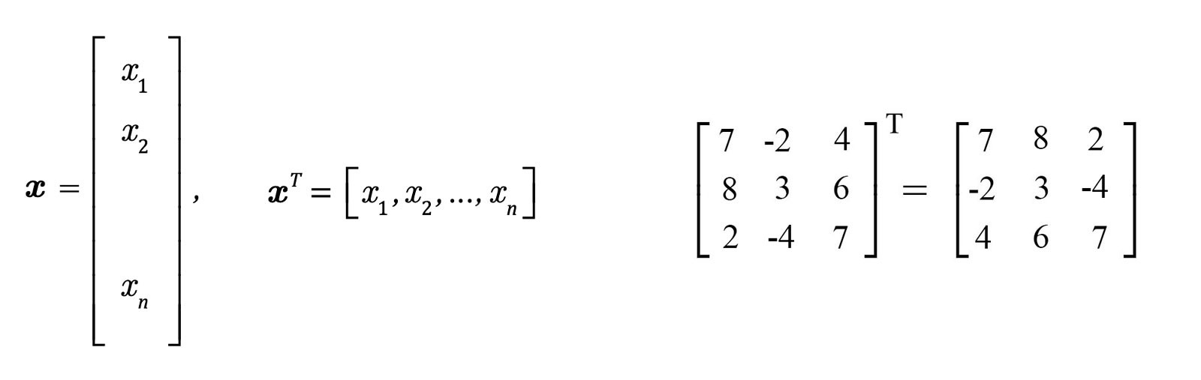
Transpose

Slide 4
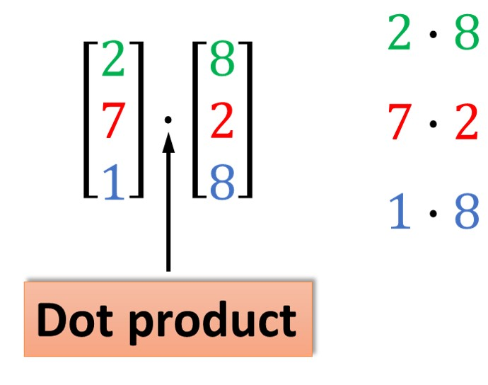
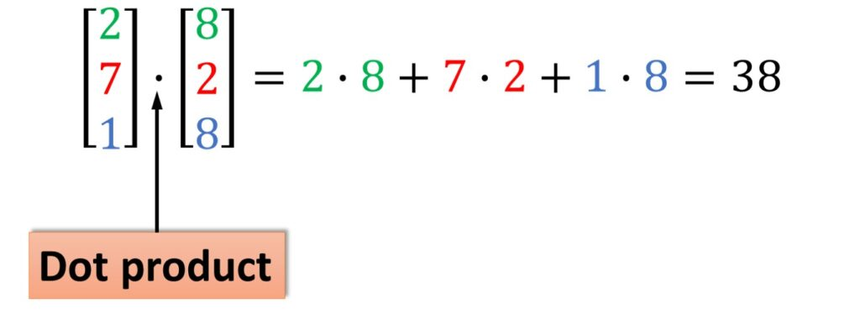
Inner or Dot Product

Slide 5
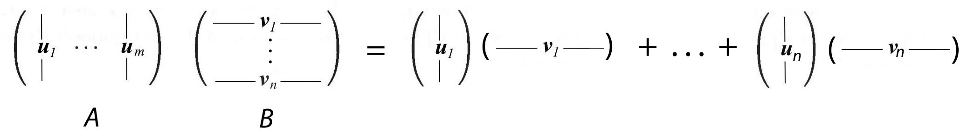
Outer product

Slide 6
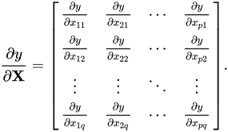
Derivative

Slide 7
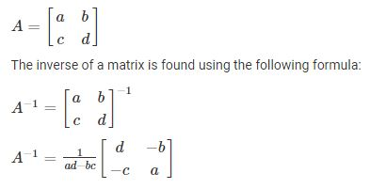
Inverse

Slide 8
Happy Learning ☺
Please Subscribe and press bell ICON

